Slide 1

Email Cache Analysis
Sam Shelton – HMRC Principal Data Analyst
Drawing insights from bulk email data

Slide 2
Email Cache Analysis
Today I will cover:
Why email caches?
Use of analytical techniques 5 W’s/H
Data cleansing
Topic Modelling
Text analysis techniques

Slide 3
Why email caches?
Complexity of Enquiries
Schedule 36 requests – statutory powers
Range in size – 1,000-200,000 documents, including attachments

Slide 4

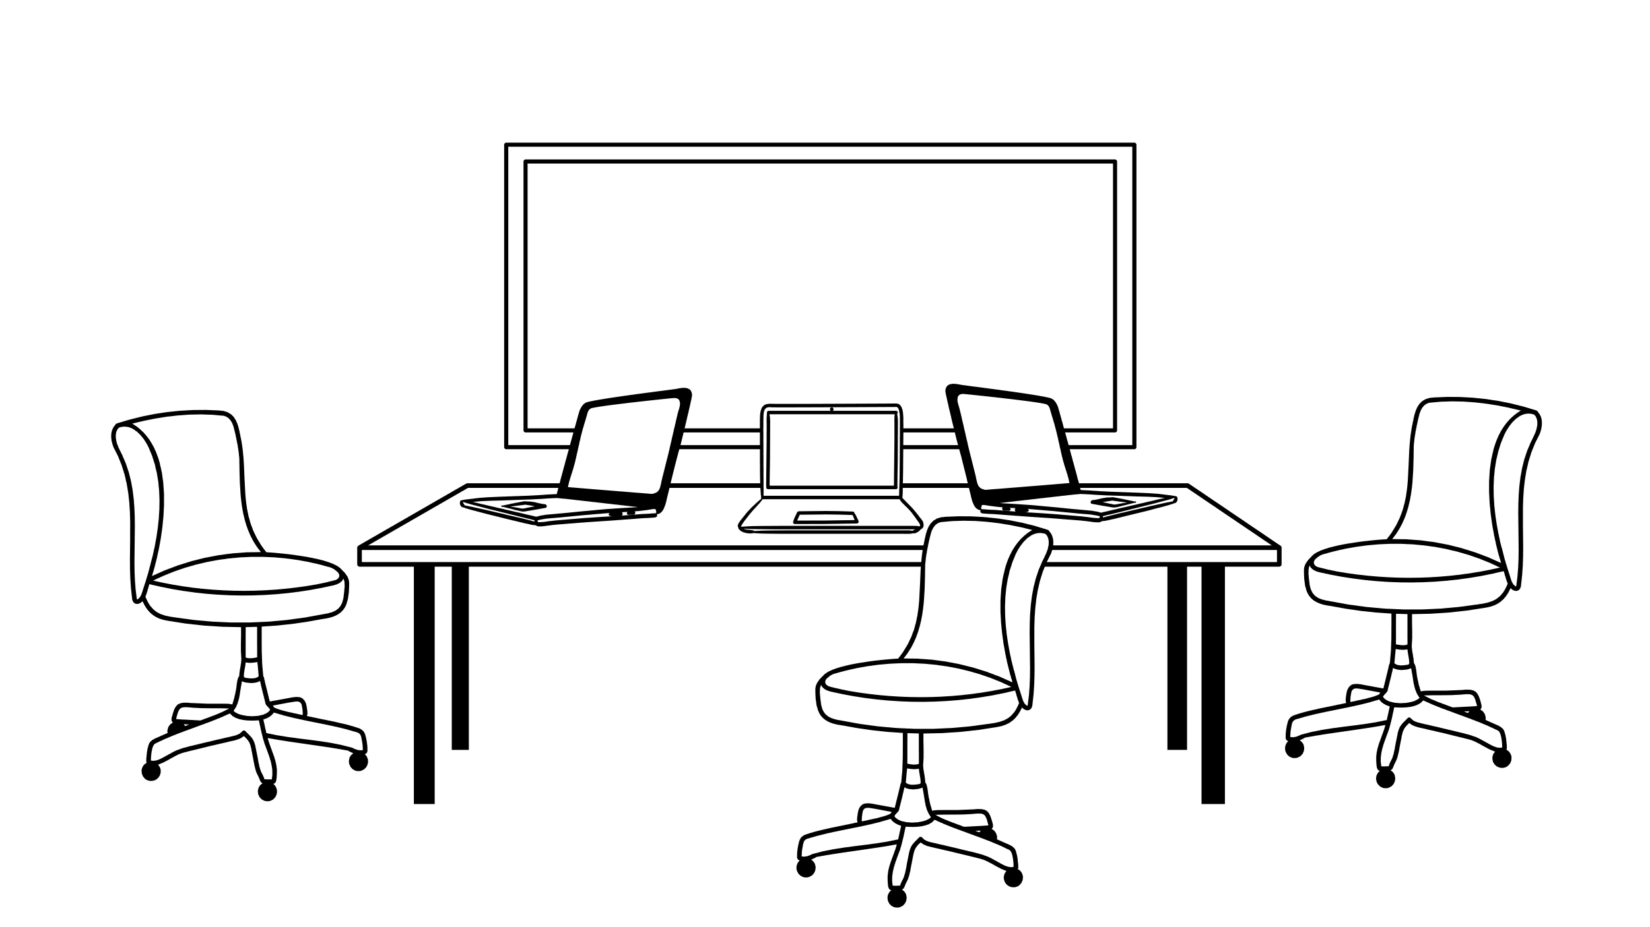


























BDEC in Large Business
In the beginning…
What happened before BDEC…
What we did in LB….
HPeD & DT Search
BDEC
Process:
Fully manual process
Often these reviews were avoided /deferred
Resources: 12+ Tax Professionals
Timelines: At least 6 months
Process:
Mostly manual process
Reviews completed when other options exhausted
Resources: 10 -12 Tax Professionals
Timelines: 3 - 6 months
Process:
Data driven process
Regularly completed reviews
Resources: 3-4 Tax Professionals, 3-4 Analysts
Timelines: 6 – 8 Weeks on average
Notes:
Talk through the past, present and future states

Slide 5

Email Cache Analysis – the 5 W’s and H
Where – In the BDEC environment, using R Studio (and a little bit of Python)
What – BDEC converts email caches and attachments to a structured dataset
Who – Data Analysts in the Large Business Data Analytics team, working closely with tax specialists
When – As the data arrives, typically we work on analysing the data for about 8 weeks
Why – Direct case teams to key documents quicker, providing wider insight as to the data itself
How – Network analysis, out of scope for today. Text analysis, very much in scope!

Slide 6






Email Cache Project
Using a cache of material requested from a business
Understand the data
Identify Persons of Interest
Discover Important Documents

Slide 7
An Email Cache Project
Sponsor requirements
Emails
Email Address Cleaning and Mapping
Text Cleaning
Documents
Topic Modelling
Text Cleaning
Topic Modelling
Text Analysis
Text Analysis
Bespoke work
Machine Learning Prediction Models case-dependent searches consultation
Scoping and agreement of work provision
Two main areas of work
Data Insights and Issue Identification
Initial Recommendations to case team
Specific Recommendations and direction case team approaches
Case Review Support
Bespoke Work
Case Review Support
Network Analysis
Interactive Shiny Application

Slide 8
An Email Cache Project
Sponsor requirements
Emails
Email Address Cleaning and Mapping
Text Cleaning
Documents
Topic Modelling
Text Cleaning
Topic Modelling
Text Analysis
Text Analysis
Bespoke work
Machine Learning Prediction Models case-dependent searches consultation
Scoping and agreement of work provision
Two main areas of work
Data Insights and Issue Identification
Initial Recommendations to case team
Specific Recommendations and direction case team approaches
Case Review Support
Bespoke Work
Case Review Support
Interactive Shiny Application
Network Analysis
Notes:
Key point to get across, the emails, and the attached word documents are very different in nature. Emails are generally passing short bits of information round, and come in chains, whilst attachments are often much more detailed in nature. Therefore they warrant a very different approach, and we split them up for the purposes of text cleansing and for topic modelling and analysis

Slide 9
Text Cleaning
Napoleon Bonaparte (born Napoleone Bonaparte;^{[1][b]} 15 August 1769 – 5 May 1821), later known by his regnal name Napoleon I, was a French military commander and political leader who rose to prominence during the French Revolution and led successful campaigns during the Revolutionary Wars. He was the leader of the French Republic as First Consul from 1799 to 1804, then of the French Empire as Emperor of the French from 1804 until 1814, and briefly again in 1815. Napoleon's political and cultural legacy endures as a celebrated and controversial leader. He initiated many liberal reforms that have persisted through the years, and is considered one of the greatest military commanders in history. His campaigns are still studied at military academies worldwide. Between three and six million soldiers and civilians died in the Napoleonic Wars.^{[2][3]}
Source: https://en.wikipedia.org/wiki/Napoleon 27/09/2023
Most text isn’t useful
Stop Words
Common words
Numbers*
Dates*
Foreign words

Slide 10
Text Cleaning
Napoleon Bonaparte (born Napoleone Bonaparte;^{[1][b]} 15 August 1769 – 5 May 1821), later known by his regnal name Napoleon I, was a French military commander and political leader who rose to prominence during the French Revolution and led successful campaigns during the Revolutionary Wars. He was the leader of the French Republic as First Consul from 1799 to 1804, then of the French Empire as Emperor of the French from 1804 until 1814, and briefly again in 1815. Napoleon's political and cultural legacy endures as a celebrated and controversial leader. He initiated many liberal reforms that have persisted through the years, and is considered one of the greatest military commanders in history. His campaigns are still studied at military academies worldwide. Between three and six million soldiers and civilians died in the Napoleonic Wars.^{[2][3]}
Source: https://en.wikipedia.org/wiki/Napoleon 27/09/2023
Most text isn’t useful
Stop Words – grammar and connecting words
Common words
Numbers*
Dates*
Foreign words

Slide 11
Text Cleaning
Napoleon Bonaparte (born Napoleone Bonaparte;^{[1][b]} 15 August 1769 – 5 May 1821), later known by his regnal name Napoleon I, was a French military commander and political leader who rose to prominence during the French Revolution and led successful campaigns during the Revolutionary Wars. He was the leader of the French Republic as First Consul from 1799 to 1804, then of the French Empire as Emperor of the French from 1804 until 1814, and briefly again in 1815. Napoleon's political and cultural legacy endures as a celebrated and controversial leader. He initiated many liberal reforms that have persisted through the years, and is considered one of the greatest military commanders in history. His campaigns are still studied at military academies worldwide. Between three and six million soldiers and civilians died in the Napoleonic Wars.^{[2][3]}
Source: https://en.wikipedia.org/wiki/Napoleon 27/09/2023
Most text isn’t useful
Stop Words – grammar and connecting words
Common words – here: 3 or more times
Numbers*
Dates*
Foreign words

Slide 12
Text Cleaning
Napoleon Bonaparte (born Napoleone Bonaparte;^{[1][b]} 15 August 1769 – 5 May 1821), later known by his regnal name Napoleon I, was a French military commander and political leader who rose to prominence during the French Revolution and led successful campaigns during the Revolutionary Wars. He was the leader of the French Republic as First Consul from 1799 to 1804, then of the French Empire as Emperor of the French from 1804 until 1814, and briefly again in 1815. Napoleon's political and cultural legacy endures as a celebrated and controversial leader. He initiated many liberal reforms that have persisted through the years, and is considered one of the greatest military commanders in history. His campaigns are still studied at military academies worldwide. Between three and six million soldiers and civilians died in the Napoleonic Wars.^{[2][3]}
Source: https://en.wikipedia.org/wiki/Napoleon 27/09/2023
Most text isn’t useful
Stop Words – grammar and connecting words
Common words – here: 3 or more times
Numbers* - may be useful
Dates*
Foreign words

Slide 13
Text Cleaning
Napoleon Bonaparte (born Napoleone Bonaparte;^{[1][b]} 15 August 1769 – 5 May 1821), later known by his regnal name Napoleon I, was a French military commander and political leader who rose to prominence during the French Revolution and led successful campaigns during the Revolutionary Wars. He was the leader of the French Republic as First Consul from 1799 to 1804, then of the French Empire as Emperor of the French from 1804 until 1814, and briefly again in 1815. Napoleon's political and cultural legacy endures as a celebrated and controversial leader. He initiated many liberal reforms that have persisted through the years, and is considered one of the greatest military commanders in history. His campaigns are still studied at military academies worldwide. Between three and six million soldiers and civilians died in the Napoleonic Wars.^{[2][3]}
Source: https://en.wikipedia.org/wiki/Napoleon 27/09/2023
Most text isn’t useful
Stop Words – grammar and connecting words
Common words – here: 3 or more times
Numbers* - may be useful
Dates* - may be useful
Foreign words

Slide 14
Text Cleaning
Napoleon Bonaparte (born Napoleone Bonaparte;^{[1][b]} 15 August 1769 – 5 May 1821), later known by his regnal name Napoleon I, was a French military commander and political leader who rose to prominence during the French Revolution and led successful campaigns during the Revolutionary Wars. He was the leader of the French Republic as First Consul from 1799 to 1804, then of the French Empire as Emperor of the French from 1804 until 1814, and briefly again in 1815. Napoleon's political and cultural legacy endures as a celebrated and controversial leader. He initiated many liberal reforms that have persisted through the years, and is considered one of the greatest military commanders in history. His campaigns are still studied at military academies worldwide. Between three and six million soldiers and civilians died in the Napoleonic Wars.^{[2][3]}
Source: https://en.wikipedia.org/wiki/Napoleon 27/09/2023
Most text isn’t useful
Stop Words – grammar and connecting words
Common words – here: 3 or more times
Numbers* - may be useful
Dates* - may be useful
Foreign words – not applicable here, but very common

Slide 15
Text Cleaning
Napoleon Bonaparte (born Napoleone Bonaparte;^{[1][b]} 15 August 1769 – 5 May 1821), later known by his regnal name Napoleon I, was a French military commander and political leader who rose to prominence during the French Revolution and led successful campaigns during the Revolutionary Wars. He was the leader of the French Republic as First Consul from 1799 to 1804, then of the French Empire as Emperor of the French from 1804 until 1814, and briefly again in 1815. Napoleon's political and cultural legacy endures as a celebrated and controversial leader. He initiated many liberal reforms that have persisted through the years, and is considered one of the greatest military commanders in history. His campaigns are still studied at military academies worldwide. Between three and six million soldiers and civilians died in the Napoleonic Wars.^{[2][3]}
Source: https://en.wikipedia.org/wiki/Napoleon 27/09/2023
Most text isn’t useful
Even after basic cleaning there is still a lot of text to analyse
We have thousands of documents
In this example we had 97 unique ‘words’, reduced to 84 …

Slide 16
Truncate Documents
Again, Most text isn’t useful
Some documents are big
We can’t use everything
Cut short the largest documents to the upper quartile – 75% of all other documents

Slide 17
Line Cleaning
Split documents into lines
Count all lines
Sort by frequency
Remove top % of lines
Removing Common Lines
Often, documents are filled with common sentences
Legal Boilerplate
Email Sign-offs
Forms
tidytext::unnest_tokens is your friend
Typically, easily spotted by checking frequency
However, the cut off point requires YOU to make a decision!
Notes:
How do we split our content up line by line? We use a function called unnest_tokens in R. It splits up text contained within a character field of a dataframe, into whatever token you require. Word by word, sentence by sentence, line by line, you can even write your own regular expression to split up the text. It’s a really powerful function from the tidytext package.
Once you have a frequency count of your lines (the table function is a good shortcut), you then have to decide what to drop. This is very context dependent. Generally emails have far more repeated lines than attached documents, so we’d be more brutal in the former. What’s relevant and what’s not is up to you to decide, in conjunction with the tax specialists working on the case.

Slide 18
Line Cleaning
Split documents into lines
Count all lines
Sort by frequency
Remove top % of lines
Remove highest impacting lines
Removing Lines by Impact
Impact is a measure defined as
length of line × frequency of line
This helps prevent any large impact on analysis and make the analysis achievable with given resources

Slide 19
Line Cleaning
Split documents into lines
Count all lines
Sort by frequency
Remove top % of lines
Remove highest impacting lines
Remove lines by inspection
Removing Lines by Inspection
At each step we review how cleaning is going
Last step – read the lines and remove appropriately
A manual step, automated as much as possible by
detecting specific words and phrases within the line

Slide 20
Stop Words
Convert lines back to full documents
Split into single words
Remove Stop-Words and chosen words
Most common phrases in a language
Essential for language making sense!
Remove the most common words in language including foreign languages
Remove a list of words chosen by inspection
Notes:
And, I, it, the etc.
If you read what’s left as prose, you probably won’t understand it. However for the purpose of our analysis, we’re not reading documents word by word, we’re analysing them to pick out trends and patterns, therefore this is fine to do
The slide mentions foreign languages – the tax risks are international in nature, and it’s quite common we get stuff in German, Dutch, French, even Greek. So this has to be accounted for as well. The stopwords function, within the tm package, has lots of different languages programmed into it.
Those chosen by inspection are often ones which become apparent after we’ve done the analysis – there may be a word often appearing in abbreviation analysis, or that’s spanning lots of topics and isn’t very meaningful, and we can just add those to the stopwords, which we anti join back to the words

Slide 21
Lemmatisation
Convert lines back to full documents
Split into single words
Remove Stop-Words and chosen words
Lemmatise words
Group similar words together
Choice of stemming or lemmatisation
Stemming – cutting off word endings to get same word run, running, runner, runs, ran → run, run, run, run, ran
Lemmatisation – a smarter approach to above by mapping run, running, runner, runs, ran → run, run, run, run, run

Slide 22

Current Approach
Effect on a case
Truncate documents
Remove Stop Words
Lemmatise
Clean Lines by
Remove words by Inspection
Frequency
Impact
Inspection
Select documents
Text Analysis
Recreate documents from cleaned words
Topic Modelling
R markdown

Slide 23
Duplicated Text – Document #1
From: Jack
To: Jill
Sent: Monday 13th May 08:43am
Subject: Weekend
Message: Hi Jill, How did your weekend go?
Regards, Jack

Slide 24
Duplicated Text – Document #2
From: Jill
To: Jack
Subject: RE: Weekend
Sent: Monday 13th May 08:47am
Message: Yeah it went well. Went shopping but they didn’t have any vinegar in the store :O
KRs, Jill
From: Jack
To: Jill
Sent: Monday 13th May 08:43am
Subject: Weekend
Message: Hi Jill, How did your weekend go?
Regards, Jack

Slide 25
Duplicated Text – Document #3
From: Jack
To: Jill
Sent: Monday 13th May 1:01pm
Subject: RE: Weekend
Message: Oh no, I’m not sure a sticky plaster will help much
Regards, Jack
From: Jill
To: Jack
Subject: RE: Weekend
Sent: Monday 13th May 08:47am
Message: Yeah it went well. Went shopping but they didn’t have any vinegar in the store :O
KRs, Jill
From: Jack
To: Jill
Sent: Monday 13th May 08:43am
Subject: Weekend
Message: Hi Jill, How did your weekend go?
Regards, Jack

Slide 26
How to deal with duplicated text
Option 1 – Do nothing!
Option 2 – Only take first email
Option 3 – Use similarity measures
Easiest to implement
Things left to chance, and we hope that common lines/stopwords helps smooth the impact of not doing anything
Find a regular expression that could be an endpoint for the top email in the file
Take everything up to the cut off
Relatively quick but may cut off important text if we don’t have the originating email
Use the email splitting regular expression within an unnest_tokens call
This will break emails into their individual responses
Use a method like similarity scoring, or locality sensitive hashing, to identify duplicates or very similar emails, and drop accordingly

Slide 27
An Email Cache Project
Sponsor requirements
Emails
Email Address Cleaning and Mapping
Text Cleaning
Documents
Topic Modelling
Text Cleaning
Topic Modelling
Text Analysis
Text Analysis
Bespoke work
Machine Learning Prediction Models case-dependent searches consultation
Scoping and agreement of work provision
Two main areas of work
Data Insights and Issue Identification
Initial Recommendations to case team
Specific Recommendations and direction case team approaches
Case Review Support
Bespoke Work
Case Review Support
Interactive Shiny Application
Network Analysis
Notes:
Topic Modelling has hopefully been covered on your course. It’s a pretty advanced technique, and one of the challenges we have is explaining it to our non-technical tax specialist stakeholders. I take round an example that illustrates the idea…

Slide 28











Topic Modelling
Grouping documents together depending on their content
Unsupervised Machine Learning
Subset the data and identify topics of interest
Notes:
We’ve used it in an unsupervised sense but there are supervised alternatives. You can choose to seed words and topics before you start, or we’ve had instances where email caches have arrived in multiple tranches. We ran topic modelling on tranches 1 and 2 together for example, but then including a third tranche, and starting from scratch, can cause topic modelling to deliver different results, and so we can stick with the topics we already had, and fit the new tranche 3 documents to those. I’m not going to cover how supervised models work, but they do exist!

Slide 29
What is Topic Modelling?
…
Alexander, Newcastle’s newest striker, scored the winning goal in tonight’s home game against Manchester United after a closely fought match.
Manchester United are still far and away the most likely to come up on top by the end of the tournament, but this has been a challenging week for them so far.
…
Identifying a topic based on words
An article about football may contains words like goal, score, striker, win, tournament, match, …
An advert for a holiday may contain words like
away, home, week, country, pool, sun, …
FOOTBALL
70%
HOLIDAY
30%

Slide 30
Document-Term-Matrix
Document 1
He is a fantastic striker.
Each document is a ‘bag of words’
Document 2
It is a cosy home with a fantastic view.
The frequency of each word matters, not their order
Each document is a collection of words
 | a | cosy | fantastic | he | is | it | home | striker | view | with
Document 1 | 1 | 0 | 1 | 1 | 1 | 0 | 0 | 1 | 0 | 0
Document 2 | 2 | 1 | 1 | 0 | 1 | 1 | 1 | 0 | 1 | 1
Notes:
The first input for topic modelling is the document term matrix. This is a huge matrix, and in practice is largely full of zeros! There are more words than documents.
If you’ve been watching closely you’ll have spotted my continuity error, ‘a’, ‘is’ and ‘it’ would probably have been cleansed out in the stopwords work! But hopefully this illustrates the input object for topic modelling

Slide 31
Topic Modelling
Topic 1
Spa
Holiday
Latent Dirichlet Allocation
Pool
Away
Sun
Home
Words may belong to multiple topics
Documents may belong to multiple topics Topic is chosen by distribution of words
We do not choose the topics beforehand Topics are based on how often words appear together
We choose the number of topics
Field
Score
Win
Player
Goal
Team
Football
Topic 2
Notes:
There are a few different algorithms for doing topic modelling, and the one we have chosen is Latent Dirichlet Allocation. I won’t cover exactly how this algorithm works, but it delivers two outputs, a beta matrix, which is the probabilities of all the words belonging to topics, and the gamma matrix, which is the probabilities of the documents belonging to topics.
The second input we have to give it, is k, the number of topics, and this is rather more difficult to decide upon.

Slide 32
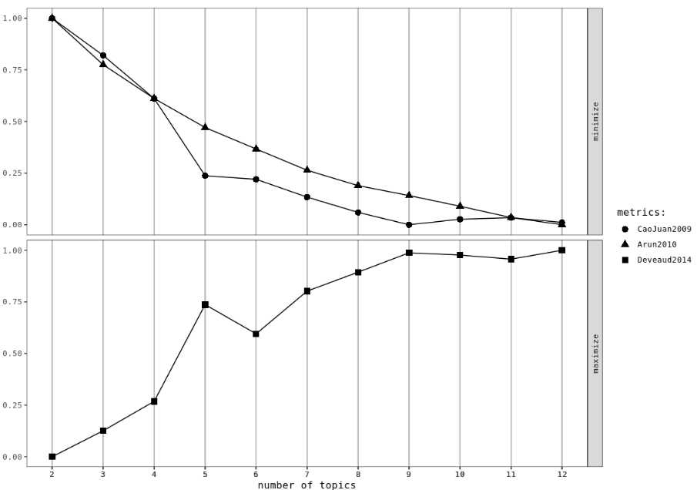
Number of Topics
A balance between
Balance of probabilities what does the maths suggest?
And
Human Interpretability do the topics make sense?
Notes:
Happily some academics have also tried to solve this for us, and come up with their own published measures, to estimate the number of topics by calculating ‘similarities’ / ‘distances’ between topics. The top 2 we look to minimise, the bottom one we look to get close to one, and we’re looking for a big jump in these measures. The Devaud measure here suggests a big improvement in moving from 4 to 5 topics for example. But it’s always a balance. We find that too many topics makes it difficult to interpret – we’re looking for enough to tell the story about what’s in the data, but having too many makes discerning what the topics are about very difficult.

Slide 33
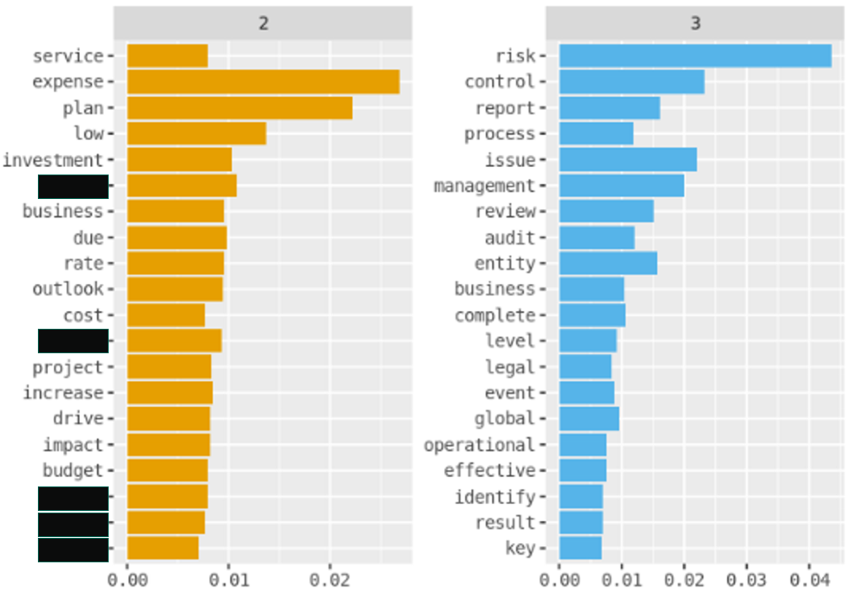
Deciphering Topics
Difficult
Find the most ‘important’ words per topic
Tax Specialists support topic identification
Notes:
We use the beta matrix to find the most relevant words in each topic, and present them in lists like this. It does require experience and tax specialist expertise to decipher what the topics are, but it’s so rewarding when you actually figure them out. They obviously vary between cases, but we often get things like accounting and financial planning, topics for internal ‘projects’ together with their codenames, there’s often a legal topic, for example facilitating an acquisition, and we often get newsletters and dumping grounds. They might sound like they’re less useful, but topic modelling means the case team can de-prioritise reviewing these documents and focus on the meatier topics instead.

Slide 34
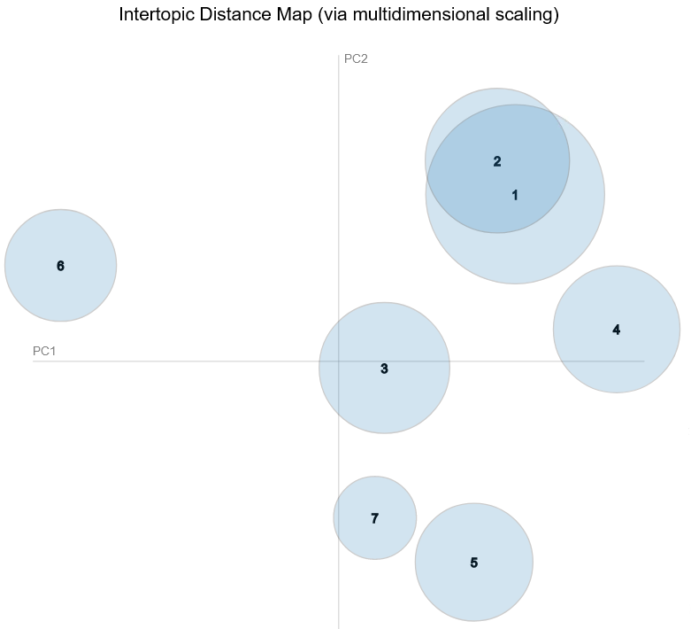
Topic Overlap
The more distinct the better
Topics naturally overlap
Sometimes topics are actually ‘subtopics’
Usefulness of the topics
Notes:
The bubble chart is an interactive visual that users can create in R, which uses principal component analysis to visualise the topics, and the overlaps, and gives you the words in each topic by relevance and pertinence.
The code is quite fiddly and involves a custom function, rather than producing the code in this slide I’ll provide a link later on to help you create it, though your topics do get rearranged into size order.
The emails and the attachments are very different in nature, and so lend themselves to being split up before you do the topic modelling.

Slide 35
Current Approach
Effect on a case
Create Document-Term-Matrix
Calculate Topic Number
Check Topic Overlap
Decipher Topics
Text Cleaning
Text Analysis
Apply Topic Modelling
Augment Data with topics
R markdown
Notes:
This is then a reminder of how the topic modelling works. In purple we have the effect on the case, and I’ll come back to that in a few moments after giving you a preview of the other bits of text analysis we can do

Slide 36
An Email Cache Project
Sponsor requirements
Emails
Email Address Cleaning and Mapping
Text Cleaning
Documents
Topic Modelling
Text Cleaning
Topic Modelling
Text Analysis
Text Analysis
Bespoke work
Machine Learning Prediction Models case-dependent searches consultation
Scoping and agreement of work provision
Two main areas of work
Data Insights and Issue Identification
Initial Recommendations to case team
Specific Recommendations and direction case team approaches
Case Review Support
Bespoke Work
Case Review Support
Interactive Shiny Application
Network Analysis

Slide 37
Text Analysis
Use a dataset of emails to
Understand the dataset
Identify Topics on Interest
Uncover Important Documents

Slide 38
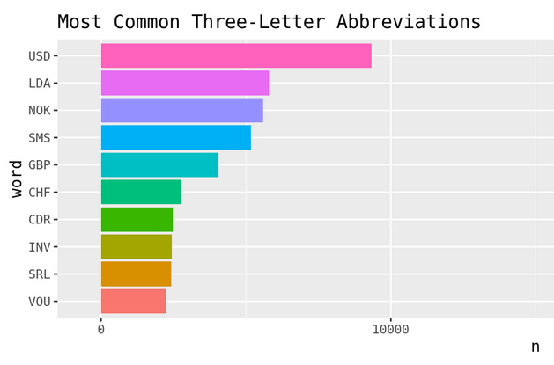
Abbreviations
Case-specific Codes
Currency is very common
USD, GBP, EUR, NOK, CHF
Project codes
Shorthand
Notes:
You might ask how do you go about identifying abbreviations? Bit of a hack, but we clash the words in the documents against the dictionary, with the help of the hunspell package. Anything leftover is assumed to be an abbreviation. Flaw to the method – any abbreviation that just so happens to be a dictionary word will be dropped. For example, RAP
This visual came from a case in the telecoms industry

Slide 39
N-grams
Unigram | Frequency
<company-name> | 36,922
tax | 26,360
agreement | 14,046
Common phrases in the data
Bigram | Frequency
financial statement | 4132
cash flow | 1651
time time | 1358
Unigrams – 1 word
Bigrams – 2 words
Trigrams – 3 words
What is being discussed?
Trigram | Frequency
federal income tax | 595
simplify execute win | 562
corporate income tax | 543
Notes:
n grams are the most common phrases and are fairly self explanatory. Remember though that we have taken the stopwords out, so in isolation some of them may not make much sense. Time time for example might have had the words like ‘to’ and ‘after’ removed. The tax specialists have access to a facility where they can text search, bringin up documents that contain certain words or phrases, and these n-grams are ideal motivation to decide what to look for.
Often some interesting phrases come up, in one case we had the bigram “"verdwijnende vennootschap” come up, which is Dutch for disappearing company, and the fact it was in Dutch may be significant. In another, the most common trigram containing the word ‘vat’ (value added tax) was KZT incl VAT. KZT is the currency code for the Kazhakstani Tenge…

Slide 40
What documents to review?
 | 1 – News-letter | 2 – Tax Planning | 3 – Project Essex | 4 - Legal | Total
Document 1 | 0.9 | 0 | 0.05 | 0.05 | 1
Document 2 | 0.87 | 0.1 | 0.03 | 0 | 1
Document 3 | 0.1 | 0.67 | 0.14 | 0.09 | 1
Document 4 | 0.07 | 0.8 | 0.1 | 0.03 | 1
Document 5 | 0.13 | 0.1 | 0.04 | 0.73 | 1
Document 6 | 0.12 | 0.45 | 0.4 | 0.03 | 1
Document 7 | 0.12 | 0.03 | 0.79 | 0.06 | 1
Gamma Matrix
Probability distribution, per document, within topics
Invariably some cross over
Take cut offs for interesting topics, e.g. P>0.6?
Notes:
Back to topic modelling, I mentioned the beta matrix earlier, which gave us the probabilities of words belonging to topics. We also have the gamma matrix, which is the probability of documents belonging to topics. Once we have a feel for what the topics are, we can then pick out the documents which come from the topics of interest. We have the ability to save collections of documents belonging to topics and present these to the case teams to review in more detail. We can also pick documents which span multiple topics of interest. But does this truly deliver case teams the documents most relevant to the enquiry?

Slide 41
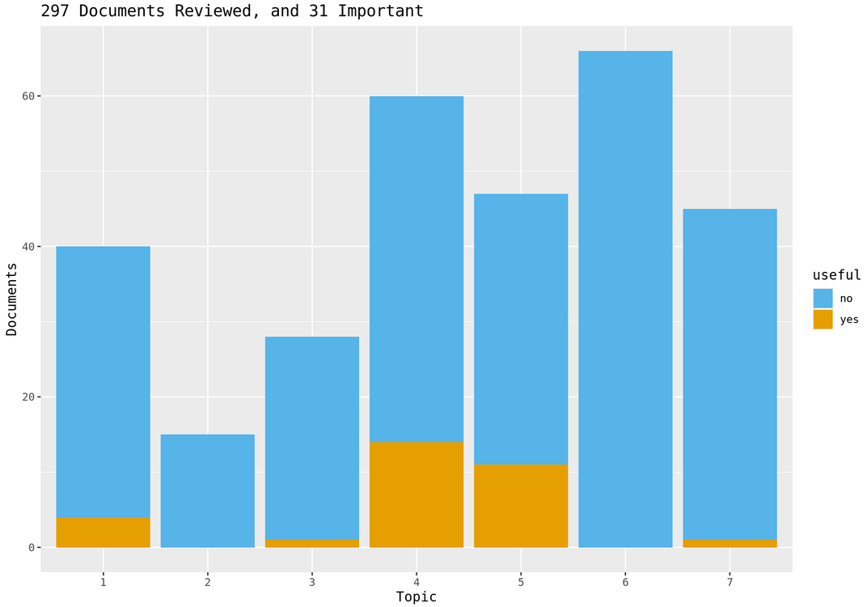
Topic Analysis
How useful are they?
Case-team reviews documents
Direct searches to better discover important documents
Evaluate the topic modelling
Notes:
Yes it does. Within the BDEC environment, case teams can mark, or annotate documents, as relevant or not relevant to the enquiry. We expect the vast majority will not be relevant, but if we overlay the documents they have reviewed, with the lead topic according to our topic modelling, we see some clear trends. The important stuff largely seems to come from topics 4 and 5. We thought initially that 6 would be important, but when we did further digging they contained some of the buzzwords but not in the context we were looking for. Of the 7 topics, 4 of them were pretty useless, and whilst we’d like some slightly larger sample sizes for some of the, especially topic 2, this is good news? It’s good because we can direct case teams to the important topics, and they don’t have to manually review all the documents from 2, 3, 6 and 7. Whilst there is a chance they could miss something, they can be confident that they’ll capture the important stuff early on, and if they don’t get round to reviewing the other documents, be pretty confident they’re not missing anything.

Slide 42
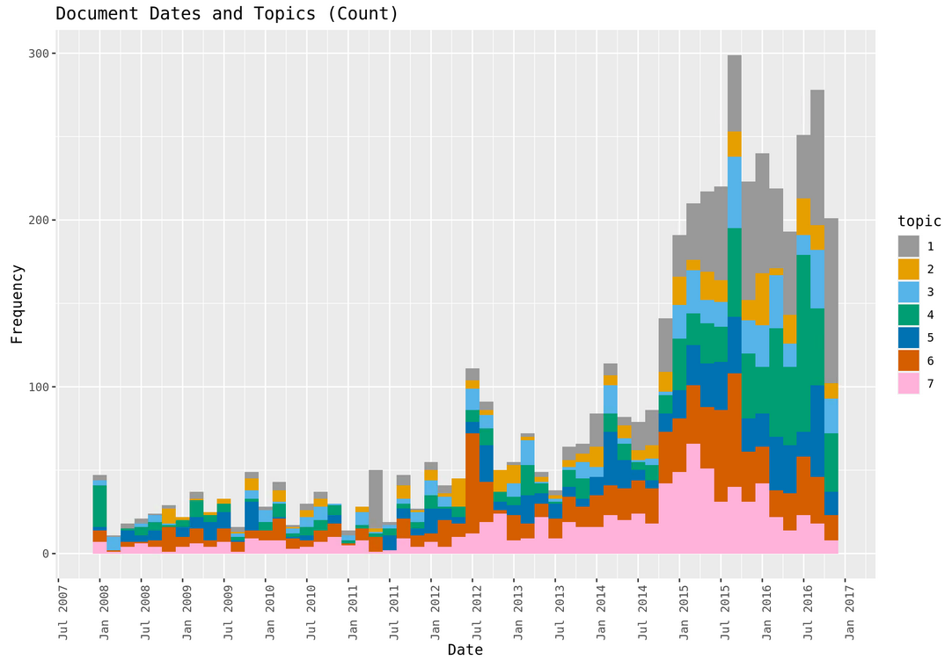
Topic Timelines
When do conversations happen?
Identify crucial periods for the business
When does a topic become the focus point for the business
Notes:
One other thing we can do with the gamma matrix is plot peaks in activity overall, and peaks in particular topics. So lots of activity in 2015, and smaller peaks earlier on too. Topic wise, March 2011 was a numper month for topic 1, and July 2012 a bumper month for topic 6, which could potentially be significant. Topic 4 shrinks a fair bit in early 2015 but fills up much more of the bar chart in late 2015 and early 2016

Slide 43
Current Approach
Effect on a case
Abbreviations
N-grams
Topic Analysis
Monitor Early Annotations
Provide Searches and recommendations
Insights
Expedite document discovery
Topic Timelines
Recommendations
R markdown

Slide 44
Questions
Email - samuel.shelton@hmrc.gov.uk

Slide 45
Appendix – code for bubble chart – WARNING: TOPIC ORDER WILL CHANGE!
# To visualise LDA we need to run the following code
topicmodels2LDAvis <- function(x, ...){
post <- topicmodels::posterior(x)
if (ncol(post[["topics"]]) < 3) stop("The model must contain > 2 topics")
mat <- x@wordassignments
LDAvis::createJSON(
phi = post[["terms"]],
theta = post[["topics"]],
vocab = colnames(post[["terms"]]),
doc.length = slam::row_sums(mat, na.rm = TRUE),
term.frequency = slam::col_sums(mat, na.rm = TRUE)
)
}
post <- topicmodels::posterior(doc_LDA)
mat <- doc_LDA@wordassignments
LDA_JSON <- createJSON(
phi = post[["terms"]],
theta = post[["topics"]],
vocab = colnames(post[["terms"]]),
doc.length = slam::row_sums(mat, na.rm = TRUE),
term.frequency = slam::col_sums(mat, na.rm = TRUE),
R = 30
)
serVis(topicmodels2LDAvis(doc_LDA),
open.browser = interactive()
)

